Slide 1

Introduction to Microservices
Ravindu Nirmal Fernando
SLIIT | March 2025
https://ravindunfernando.com

Slide 2
Foundations of Modern Software Architecture: Paving the Way for Microservices
Influential Concepts and Technologies
Domain-Driven Design: Emphasizing the importance of reflecting real-world complexities in our code for better system modeling.
Continuous Delivery: Revolutionizing software deployment, making every code check-in a potential release candidate.
Web Communication Advancements: Enhancing how machines interact, leading to more efficient and robust systems.
Architectural Shifts
From Layered to Hexagonal: Moving away from traditional layered architectures to avoid hidden complexities in business logic.
Embracing Virtualization: Utilizing on-demand provisioning and resizing of resources for greater flexibility with cloud computing.
Organizational Practices
Small Autonomous Teams: Inspired by tech giants like Amazon and Google, promoting ownership and lifecycle management of services.
Learning from Netflix: Building resilient, scalable systems that can withstand and adapt to change.

Slide 3
Microservices: A Natural Progression
Emergence from Real-World Use: Microservices weren’t pre-planned but evolved as a response to practical needs in software development.
Responding to Change: Offering the agility and flexibility to adapt to new technologies and market demands.

Slide 4
Monolithic Applications
Basic Structure
Single-Tiered Structure: Built as a single, unified unit.
Combined Modules: Functional modules like UI, server logic, and database interactions are combined.
Design and Construction
Modular Architecture: Follows a modular structure within a single unit, aligning with object-oriented principles.
Programming Constructs: Defined using language-specific constructs (e.g., Java packages).
Build Artifacts: Built as a single artifact, such as a Java JAR file.
Characteristics
Inter-module Dependencies: Modules are tightly coupled and interdependent.
Unified Deployment: Deployed as a single entity.
Scalability
Scalability Approach: Scaling involves replicating the entire application, not individual components.

Slide 5
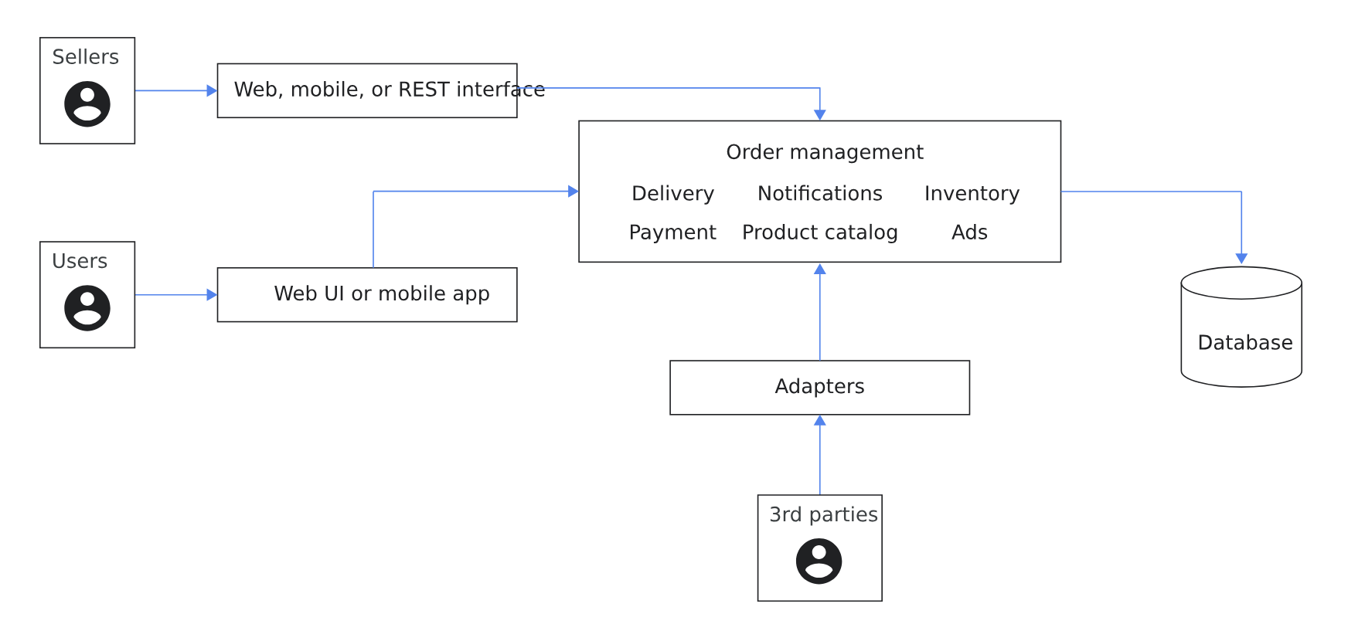
Diagram of a monolithic ecommerce application with several modules using a combination of programming language constructs. (https://cloud.google.com/architecture/microservices-architecture-introduction)

Slide 6
Benefits of Monolithic Architecture
Simplified Testing: Tools like Selenium enable end-to-end testing of the entire application.
Ease of Deployment: Deployment involves simply copying the packaged application to a server.
Resource Sharing: All modules share memory, space, and resources, streamlining cross-cutting concerns like logging, caching, and security.
Intra-Process Communication: Direct module-to-module calls can offer performance advantages over network-dependent microservices.
Challenges of Monolithic Architecture
Scalability Issues: Difficulty in scaling when different modules have conflicting resource requirements.
Complexity in Maintenance and Updates: As the application grows, implementing changes becomes more complicated due to tightly coupled modules.
CI/CD Complications: Continuous integration and deployment become challenging as any update requires redeploying the entire application.
Vulnerability to System Failures: A bug in any module, like a memory leak, can crash the entire system.
Technological Rigidity: Adopting new frameworks or languages is costly and time-consuming, as it often requires rewriting the entire application.

Slide 7
Understanding Microservices
Core Characteristics
Small and Focused: Aimed at doing one thing well, avoiding sprawling codebases.
Cohesion and Single Responsibility: Adhering to the principle of grouping related code and separating unrelated functionalities.
Size and Scope
No Fixed Size: Size varies based on language expressiveness and domain complexity.
Team Alignment: Ideally sized to be managed by a small team.
Balance in Size: Smaller services maximize benefits but increase complexity.

Slide 8
Autonomy
Independent Entities: Deployed separately, can be different technologies, possibly as isolated services on a PAAS or as individual operating system processes.
Network Communication: Services communicate via network calls, ensuring separation and reducing tight coupling.
Deployment and Change Management
Independent Deployment: Services can be deployed independently without impacting others.
API-Centric Interaction: Services expose APIs for interaction, emphasizing decoupled, technology-agnostic interfaces.
Decoupling
Key to Microservices: Essential for maintaining independence and achieving the benefits of microservices architecture.
Change and Deployment: Ability to change and deploy a service independently is crucial.

Slide 9
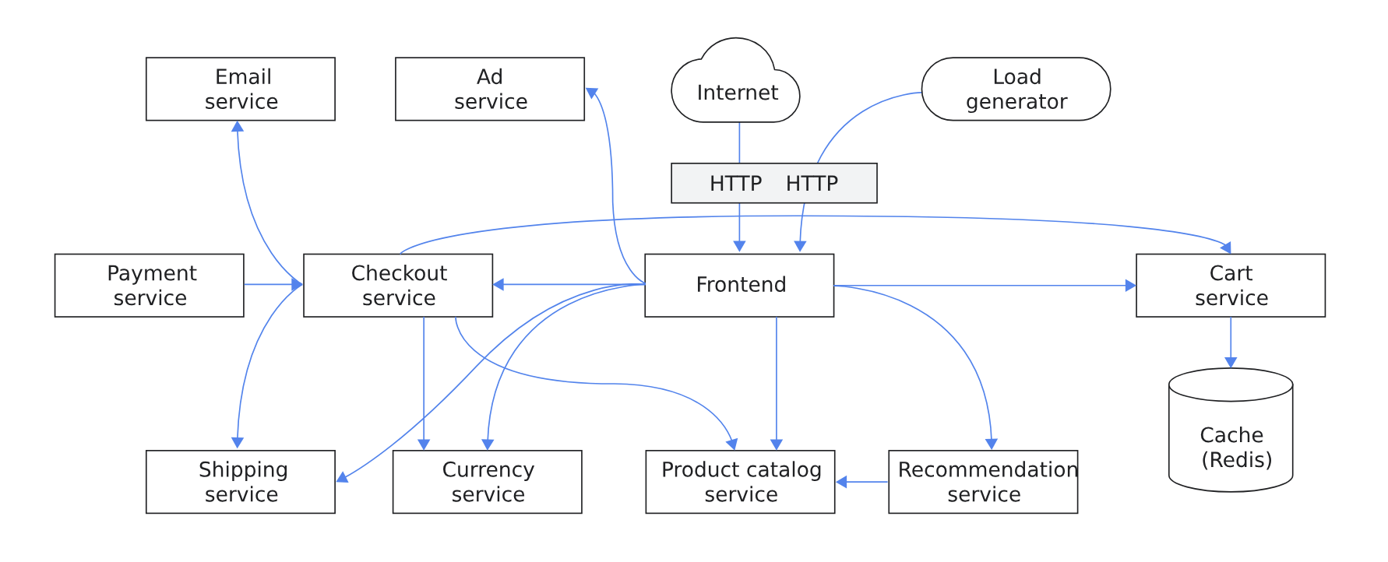
Diagram of an ecommerce application with functional areas implemented by microservices. (https://cloud.google.com/architecture/microservices-architecture-introduction)

Slide 10
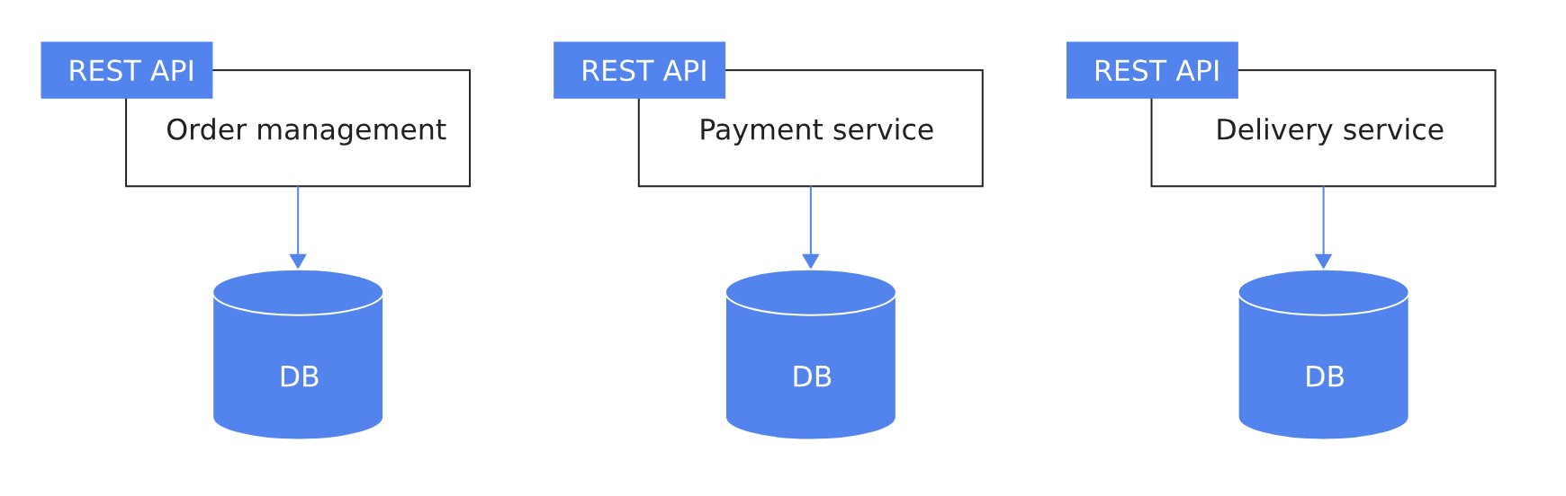
Database Relationship
Service-Specific Databases: Each microservice has its own database tailored to its requirements.
Loose Coupling: This approach ensures loose coupling by routing data requests through service APIs instead of a shared database.
Independent Data Management: Each service manages its data independently, enhancing autonomy and reducing interdependencies.

Slide 11
Benefits of Microservices Architecture
Aspect | Benefit Details
Enhanced Development and Maintenance | - Breaks application into smaller, manageable chunks. - Clear boundaries with defined APIs. - Quicker development, easier understanding and maintenance.
Team Autonomy and Efficiency | - Independent development of services by teams. - Full lifecycle ownership of services. - Flexibility to use different programming languages (Polyglot Development).
Improved Scalability and Market Responsiveness | - Independent scaling based on service needs. - Hardware optimization for resource requirements. - Faster product delivery and improved time to market.

Slide 12
Challenges of Microservices Architecture
Challenge Category | Challenge Details
Complexity in Distributed Systems | - Necessity of choosing and implementing inter-service communication mechanisms. - Managing partial failures and service unavailability.
Transaction Management Across Services | - Handling atomic operations across multiple microservices (Distributed Transactions). - Maintaining data consistency during failures (Consistency Issues).
Testing and Deployment Complexities | - Requirement for comprehensive testing across multiple services. - Complexities in managing multiple service deployments and service discovery.
Operational Overhead | - Increased need for monitoring and alerting across more services. - Higher risk of failure due to more points of service-to-service communication. - Challenges in productionizing and maintaining robust operations infrastructure.
Performance and Suitability Considerations | - Potential latency issues due to network calls between services. - Not suitable for all types of applications, especially those requiring real-time data processing. - Importance of clear communication and service boundary planning.

Slide 13
Migrating from Monolithic to Microservices: Key Considerations
Consideration Category | Details
Assessing the Need for Migration | - Evaluate if microservices align with business goals and pain points. - Consider simpler alternatives like autoscaling or enhanced testing.
Starting the Migration Process | - Begin with extracting and deploying one service independently. - Adopt an iterative approach, learning and adapting with each service migration.
Strategic Implementation | - Recognize varying approaches to microservice size and quantity among teams. - Emphasize continuous learning and strategy refinement.
Future Learning and Strategies | - Explore strategies for detailed refactoring from monolithic to microservices. - Plan for ongoing education and adaptation of methods.

Slide 14
References
https://cloud.google.com/architecture/microservices-architecture-introduction
Building Microservices, Sam Newman

